Slide 1
Relations
Prof. Chandan Trivedi
2CS802 - MFCS

Slide 2
Relations
If we want to describe a relationship between elements of two sets A and B, we can use ordered pairs with their first element taken from A and their second element taken from B.
Since this is a relation between two sets, it is called a binary relation.
Definition: Let A and B be sets. A binary relation from A to B is a subset of A×B.
In other words, for a binary relation R we have
R ⊆ A×B. We use the notation aRb to denote that (a, b)∈R and aRb to denote that (a, b)∉R.
2CS802 - MFCS

Slide 3
Relations
When (a, b) belongs to R, a is said to be related to b by R.
Example: Let P be a set of people, C be a set of cars, and D be the relation describing which person drives which car(s).
P = {Carl, Suzanne, Peter, Carla},
C = {Mercedes, BMW, tricycle}
D = {(Carl, Mercedes), (Suzanne, Mercedes),
(Suzanne, BMW), (Peter, tricycle)}
This means that Carl drives a Mercedes, Suzanne drives a Mercedes and a BMW, Peter drives a tricycle, and Carla does not drive any of these vehicles.
2CS802 - MFCS

Slide 4
Functions as Relations
You might remember that a function f from a set A to a set B assigns a unique element of B to each element of A.
The graph of f is the set of ordered pairs (a, b) such that b = f(a).
Since the graph of f is a subset of A×B, it is a relation from A to B.
Moreover, for each element a of A, there is exactly one ordered pair in the graph that has a as its first element.
2CS802 - MFCS

Slide 5
Functions as Relations
Conversely, if R is a relation from A to B such that every element in A is the first element of exactly one ordered pair of R, then a function can be defined with R as its graph.
This is done by assigning to an element a∈A the unique element b∈B such that (a, b)∈R.
2CS802 - MFCS

Slide 6
Relations on a Set
Definition: A relation on the set A is a relation from A to A.
In other words, a relation on the set A is a subset of A×A.
Example: Let A = {1, 2, 3, 4}. Which ordered pairs are in the relation R = {(a, b) | a < b} ?
2CS802 - MFCS

Slide 7
Relations on a Set
Solution: R = {
(1, 2),
(1, 3),
(1, 4),
(2, 3),
(2, 4),
(3, 4)}
1
1
R
1
2
3
4
1
X
X
X
2
2
2
X
X
3
3
3
X
4
4
4
2CS802 - MFCS

Slide 8
Relations on a Set
How many different relations can we define on a set A with n elements?
A relation on a set A is a subset of A×A.
How many elements are in A×A ?
There are n² elements in A×A, so how many subsets (= relations on A) does A×A have?
The number of subsets that we can form out of a set with m elements is 2^{m}. Therefore, 2^{n2} subsets can be formed out of A×A.
Answer: We can define 2^{n2} different relations
on A.
2CS802 - MFCS

Slide 9
Properties of Relations
We will now look at some useful ways to classify relations.
Definition: A relation R on a set A is called reflexive if (a, a)∈R for every element a∈A.
Are the following relations on {1, 2, 3, 4} reflexive?
R = {(1, 1), (1, 2), (2, 3), (3, 3), (4, 4)}
No.
R = {(1, 1), (2, 2), (2, 3), (3, 3), (4, 4)}
Yes.
R = {(1, 1), (2, 2), (3, 3)}
No.
Definition: A relation on a set A is called irreflexive if (a, a)∉R for every element a∈A.
2CS802 - MFCS

Slide 10
Properties of Relations
Definitions:
Symmetric
Antisymmetric
Asymmetric
Transitive
2CS802 - MFCS

Slide 11
Symmetric
A relation R on a set A is called symmetric if (b,a) ∈R holds when (a,b) ∈ R
Ex.{(1,2),(2,1),(3,4),(4,3)}
2CS802 - MFCS

Slide 12
Antisymmetric
Definitions:
Relation R is antisymmetric if either (x,y) ∉R or (y,x) ∉R whenever x not equal to y.
A relation R is said to be antisymmetric on a Set A if xRy and yRx hold when x=y.
2CS802 - MFCS

Slide 13
Example:
{(1,2),(2,3)} Antisymmetric
{(1,2),(2,3),(3,3)} Antisymmetric
{(1,2)(2,1)(3,3)} Not Antisymmetric
2CS802 - MFCS

Slide 14
Asymmetric
A relation R on a set A is called asymmetric if no (b,a) ∈R when (a,b) ∈R
Ex:
{(1,2),(2,3)}
2CS802 - MFCS

Slide 15
Properties of Relations
Are the following relations on {1, 2, 3, 4}
symmetric, antisymmetric, or asymmetric?
R = {(1, 1), (1, 2), (2, 1), (3, 3), (4, 4)}
symmetric
R = {(1, 1)}
sym. and antisym.
R = {(1, 3), (3, 2), (2, 1)}
antisym. and asym.
R = {(4, 4), (3, 3), (1, 4)}
antisym.
2CS802 - MFCS

Slide 16
Properties of Relations
Definition: A relation R on a set A is called transitive if whenever (a, b)∈R and (b, c)∈R, then (a, c)∈R for a, b, c∈A.
Are the following relations on {1, 2, 3, 4}
transitive?
R = {(1, 1), (1, 2), (2, 2), (2, 1), (3, 3)}
Yes.
R = {(1, 3), (3, 2), (2, 1)}
No.
R = {(2, 4), (4, 3), (2, 3), (4, 1)}
No.
2CS802 - MFCS

Slide 17
Counting Relations
Example: How many different reflexive relations can be defined on a set A containing n elements?
Solution: Relations on R are subsets of A×A, which contains n² elements.
Therefore, different relations on A can be generated by choosing different subsets out of these n² elements, so there are 2^{n2} relations.
A reflexive relation, however, must contain the n elements (a, a) for every a∈A.
Consequently, we can only choose among n² – n =
n(n – 1) elements to generate reflexive relations, so there are 2^{n(n – 1)} of them.
2CS802 - MFCS

Slide 18
Combining Relations
Relations are sets, and therefore, we can apply the usual set operations to them.
If we have two relations R₁ and R₂, and both of them are from a set A to a set B, then we can combine them to R₁ ∪ R₂, R₁ ∩ R₂, or R₁ – R₂.
In each case, the result will be another relation from A to B.
2CS802 - MFCS

Slide 19
n-ary Relations
In order to study an interesting application of relations, namely databases, we first need to generalize the concept of binary relations to n-ary relations.
Definition: Let A₁, A₂, …, A_{n} be sets. An n-ary relation on these sets is a subset of A₁×A₂×…×A_{n}.
The sets A₁, A₂, …, A_{n} are called the domains of the relation, and n is called its degree.
2CS802 - MFCS

Slide 20
n-ary Relations
Example:
Let R = {(a, b, c) | a = 2b ∧ b = 2c with a, b, c∈N}
What is the degree of R?
The degree of R is 3, so its elements are triples.
What are its domains?
Its domains are all equal to the set of integers.
Is (2, 4, 8) in R?
No.
Is (4, 2, 1) in R?
Yes.
2CS802 - MFCS

Slide 21
Representing Relations
We already know different ways of representing relations. We will now take a closer look at two ways of representation: Zero-one matrices and directed graphs.
If R is a relation from A = {a₁, a₂, …, a_{m}} to B =
{b₁, b₂, …, b_{n}}, then R can be represented by the zero-one matrix M_{R} = [m_{ij}] with
m_{ij} = 1, if (a_{i}, b_{j})∈R, and
m_{ij} = 0, if (a_{i}, b_{j})∉R.
Note that for creating this matrix we first need to list the elements in A and B in a particular, but arbitrary order.
2CS802 - MFCS

Slide 22
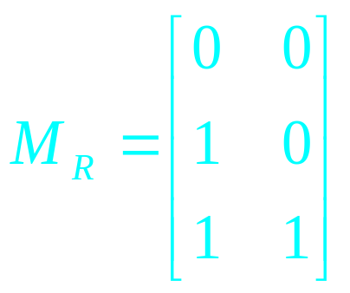
Representing Relations
Example: How can we represent the relation
R = {(2, 1), (3, 1), (3, 2)} as a zero-one matrix?
Solution: The matrix M_{R} is given by
2CS802 - MFCS

Slide 23
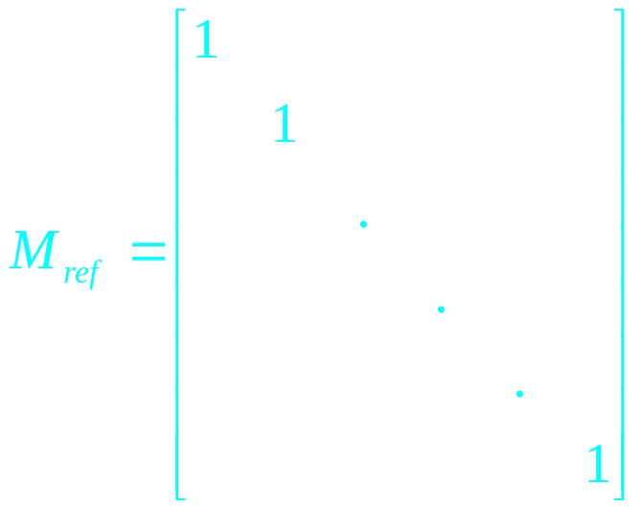
Representing Relations
What do we know about the matrices representing a relation on a set (a relation from A to A) ?
They are square matrices.
What do we know about matrices representing reflexive relations?
All the elements on the diagonal of such matrices M_{ref} must be 1s.
2CS802 - MFCS

Slide 24
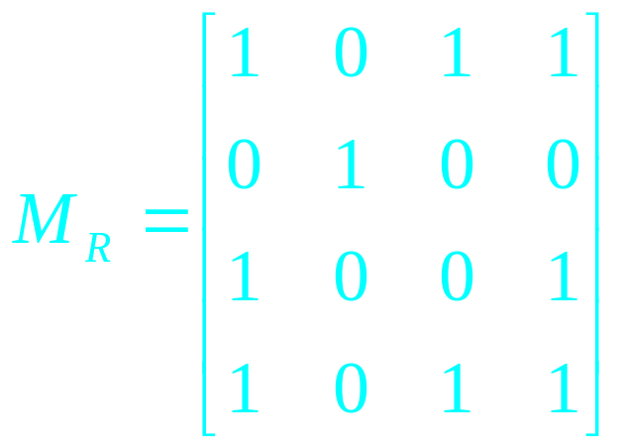
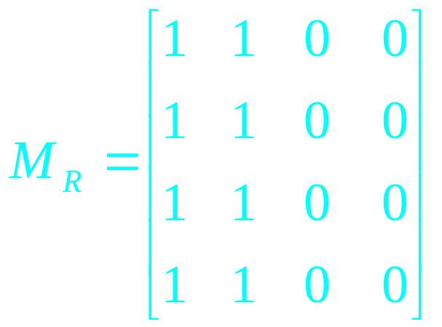
Representing Relations
What do we know about the matrices representing symmetric relations?
These matrices are symmetric, that is, M_{R} = (M_{R})^{t}.
symmetric matrix,
symmetric relation.
non-symmetric matrix,
non-symmetric relation.
2CS802 - MFCS

Slide 25
Representing Relations
The Boolean operations join and meet (you remember?) can be used to determine the matrices representing the union and the intersection of two relations, respectively.
To obtain the join of two zero-one matrices, we apply the Boolean “or” function to all corresponding elements in the matrices.
To obtain the meet of two zero-one matrices, we apply the Boolean “and” function to all corresponding elements in the matrices.
2CS802 - MFCS

Slide 26
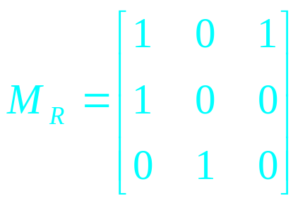
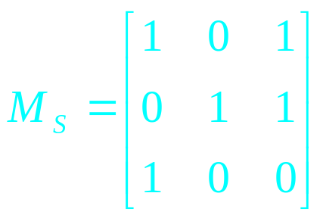
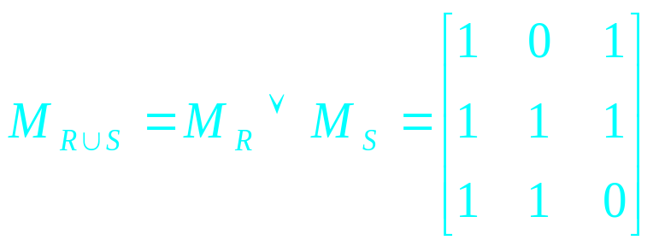
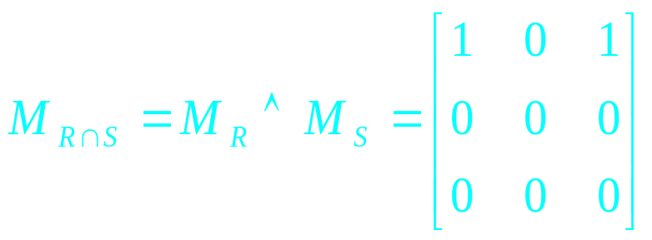
Representing Relations
Example: Let the relations R and S be represented by the matrices
What are the matrices representing R∪S and R∩S?
Solution: These matrices are given by
2CS802 - MFCS

Slide 27
Representing Relations Using Matrices
Example: Let the relations R and S be represented by the matrices
What are the matrices representing R∪S and R∩S?
Solution: These matrices are given by
2CS802 - MFCS

Slide 28
Representing Relations Using Matrices
Do you remember the Boolean product of two zero-one matrices?
Let A = [a_{ij}] be an m×k zero-one matrix and
B = [b_{ij}] be a k×n zero-one matrix.
Then the Boolean product of A and B, denoted by AοB, is the m×n matrix with (i, j)th entry [c_{ij}], where
c_{ij} = (a_{i1} ∧ b_{1j}) ∨ (a_{i2} ∧ b_{2i}) ∨ … ∨ (a_{ik} ∧ b_{kj}).
c_{ij} = 1 if and only if at least one of the terms
(a_{in} ∧ b_{nj}) = 1 for some n; otherwise c_{ij} = 0.
2CS802 - MFCS

Slide 29
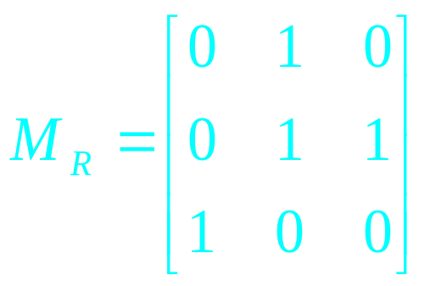
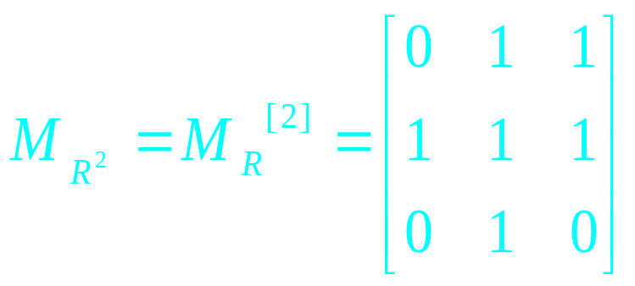
Representing Relations Using Matrices
Example: Find the matrix representing R², where the matrix representing R is given by
Solution: The matrix for R² is given by
First row- {(0^0)v (1^0) v (0^1)}= 0 V 0 V 0 = 0
Second row={(0^1)v(1^1)v(0v0)=1, and so on
2CS802 - MFCS

Slide 30
Representing Relations Using Digraphs
Definition: A directed graph, or digraph, consists of a set V of vertices (or nodes) together with a set E of ordered pairs of elements of V called edges (or arcs).
The vertex a is called the initial vertex of the edge (a, b), and the vertex b is called the terminal vertex of this edge.
We can use arrows to display graphs.
2CS802 - MFCS

Slide 31
Representing Relations Using Digraphs
Example: Display the digraph with V = {a, b, c, d},
E = {(a, b), (a, d), (b, b), (b, d), (c, a), (c, b), (d, b)}.
a
b
d
c
An edge of the form (b, b) is called a loop.
2CS802 - MFCS

Slide 32
Representing Relations Using Digraphs
Obviously, we can represent any relation R on a set A by the digraph with A as its vertices and all pairs (a, b)∈R as its edges.
Vice versa, any digraph with vertices V and edges E can be represented by a relation on V containing all the pairs in E.
This one-to-one correspondence between relations and digraphs means that any statement about relations also applies to digraphs, and vice versa.
2CS802 - MFCS

Slide 33
Equivalence Relations
Equivalence relations are used to relate objects that are similar in some way.
Definition: A relation on a set A is called an equivalence relation if it is reflexive, symmetric, and transitive.
Two elements that are related by an equivalence relation R are called equivalent.
2CS802 - MFCS

Slide 34
Equivalence Relations
Since R is symmetric, a is equivalent to b whenever b is equivalent to a.
Since R is reflexive, every element is equivalent to itself.
Since R is transitive, if a and b are equivalent and b and c are equivalent, then a and c are equivalent.
Obviously, these three properties are necessary for a reasonable definition of equivalence.
2CS802 - MFCS

Slide 35
Equivalence Relations
Example: Suppose that R is the relation on the set of strings that consist of English letters such that aRb if and only if l(a) = l(b), where l(x) is the length of the string x. Is R an equivalence relation?
Solution:
R is reflexive, because l(a) = l(a) and therefore
aRa for any string a.
R is symmetric, because if l(a) = l(b) then l(b) =
l(a), so if aRb then bRa.
R is transitive, because if l(a) = l(b) and l(b) = l(c),
then l(a) = l(c), so aRb and bRc implies aRc.
R is an equivalence relation.
2CS802 - MFCS

Slide 36
More examples
1. Equality (=) is an equivalence relation. It is of course enormously important, but is not a very interesting example, since no two distinct objects are related by equality.
2. Congruence modulo m-Suppose A is Z and n is a fixed positive integer. Let a∼b mean that a≡b(modn). The fact that this is an equivalence relation follows from standard properties of congruence (see theorem 3.1.3).
3.Let A be the set of all words. If a,b∈A, define a∼b to mean that a and b have the same number of letters; ∼ is an equivalence relation.
2CS802 - MFCS

Slide 37
Equivalence Classes
Definition: Let R be an equivalence relation on a set A. The set of all elements that are related to an element a of A is called the equivalence class
of a.
The equivalence class of a with respect to R is denoted by [a]_{R}.
When only one relation is under consideration, we will delete the subscript R and write [a] for this equivalence class.
If b∈[a]_{R}, b is called a representative of this equivalence class.
2CS802 - MFCS

Slide 38
Equivalence Classes
Example: In the previous example (strings of identical length), what is the equivalence class of the word mouse, denoted by [mouse] ?
Solution: [mouse] is the set of all English words containing five letters.
For example, ‘horse’ would be a representative of this equivalence class.
2CS802 - MFCS

Slide 39
Equivalence Classes
Theorem: Let R be an equivalence relation on a set A. The following statements are equivalent:
aRb
[a] = [b]
[a] ∩ [b] ≠ ∅
Definition: A partition of a set S is a collection of disjoint nonempty subsets of S that have S as their union. In other words, the collection of subsets A_{i},
i∈I, forms a partition of S if and only if
(i) A_{i} ≠ ∅ for i∈I
A_{i} ∩ A_{j} = ∅, if i ≠ j
∪_{i∈I} A_{i} = S
2CS802 - MFCS

Slide 40
Equivalence Classes
Examples: Let S be the set {u, m, b, r, o, c, k, s}.
Do the following collections of sets partition S ?
{{m, o, c, k}, {r, u, b, s}}
yes.
{{c, o, m, b}, {u, s}, {r}}
no (k is missing).
{{b, r, o, c, k}, {m, u, s, t}}
no (t is not in S).
{{u, m, b, r, o, c, k, s}}
yes.
{{b, o, o, k}, {r, u, m}, {c, s}}
yes ({b,o,o,k} = {b,o,k}).
{{u, m, b}, {r, o, c, k, s}, ∅}
no (∅ not allowed).
2CS802 - MFCS

Slide 41
Equivalence Classes
Theorem: Let R be an equivalence relation on a
set S. Then the equivalence classes of R form a partition of S. Conversely, given a partition
{A_{i} | i∈I} of the set S, there is an equivalence relation R that has the sets A_{i}, i∈I, as its equivalence classes.
2CS802 - MFCS

Slide 42
Equivalence Classes
Example: Let us assume that Frank, Suzanne and George live in Boston, Stephanie and Max live in Lübeck, and Jennifer lives in Sydney.
Let R be the equivalence relation {(a, b) | a and b live in the same city} on the set P = {Frank, Suzanne, George, Stephanie, Max, Jennifer}.
Then R = {(Frank, Frank), (Frank, Suzanne),
(Frank, George), (Suzanne, Frank), (Suzanne, Suzanne), (Suzanne, George), (George, Frank),
(George, Suzanne), (George, George), (Stephanie,
Stephanie), (Stephanie, Max), (Max, Stephanie),
(Max, Max), (Jennifer, Jennifer)}.
2CS802 - MFCS

Slide 43
Equivalence Classes
Then the equivalence classes of R are:
{{Frank, Suzanne, George}, {Stephanie, Max}, {Jennifer}}.
This is a partition of P.
The equivalence classes of any equivalence relation R defined on a set S constitute a partition of S, because every element in S is assigned to exactly one of the equivalence classes.
2CS802 - MFCS

Slide 44
Equivalence Classes
Another example: Let R be the relation
{(a, b) | a ≡ b (mod 3)} on the set of integers.
Is R an equivalence relation?
Yes, R is reflexive, symmetric, and transitive.
What are the equivalence classes of R ?
{{…, -6, -3, 0, 3, 6, …},
{…, -5, -2, 1, 4, 7, …},
{…, -4, -1, 2, 5, 8, …}}
2CS802 - MFCS

Slide 45
Closures of Relations
2CS802 - MFCS

Slide 46
Relational closures
Three types we will study
  Reflexive
  Symmetric
  Transitive
2CS802 - MFCS

Slide 47
Reflexive closure
Consider a relation R:
  Note that it is not reflexive
We want to add edges to
make the relation reflexive
By adding those edges,
we have made a non-
reflexive relation R into
a reflexive relation
This new relation is called the reflexive closure of R
2CS802 - MFCS

Slide 48
Reflexive closure
In order to find the reflexive closure of a relation R, we add a loop at each node that does not have one
The reflexive closure of R is R U Δ
  Where Δ = { (a,a) | a ∈ R }
    Called the “diagonal relation”
  With matrices, we set the diagonal to all 1’s
2CS802 - MFCS

Slide 49
Rosen, section 7.4, question 1(a)
Let R be a relation on the set { 0, 1, 2, 3 } containing the ordered pairs (0,1), (1,1), (1,2), (2,0), (2,2), and (3,0)
What is the reflexive closure of R?
We add all pairs of edges (a,a) that do not already exist
0
1
We add edges:
R’’= (0,0), (3,3)
(0,1), (1,1), (1,2), (2,0), (2,2), (3,0), (3,2)
3
2
2CS802 - MFCS

Slide 50
Symmetric closure
Consider a relation R:
  Note that it is not symmetric
We want to add edges to
make the relation symmetric
By adding those edges,
we have made a non-
symmetric relation R into
a symmetric relation
This new relation is called the symmetric closure of R
2CS802 - MFCS

Slide 51
Symmetric closure
In order to find the symmetric closure of a relation R, we add an edge from a to b, where there is already an edge from b to a
The symmetric closure of R is R U R⁻¹
  If R = { (a,b) | … }
  Then R⁻¹ = { (b,a) | … }
2CS802 - MFCS

Slide 52
Rosen, section 7.4, question 1(b)
Let R be a relation on the set { 0, 1, 2, 3 } containing the ordered pairs (0,1), (1,1), (1,2), (2,0), (2,2), and (3,0)
What is the symmetric closure of R?
We add all pairs of edges (a,b) where (b,a) exists
0
1
We add edges:
(0,2), (0,3)
(1,0), (2,1)
3
2
2CS802 - MFCS

Slide 53
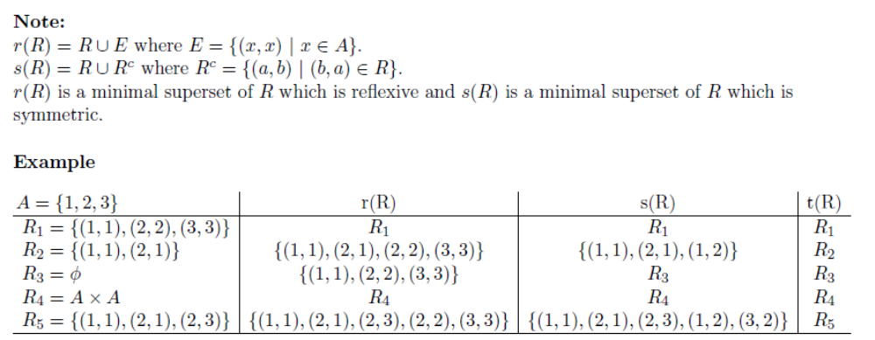
Some examples
2CS802 - MFCS

Slide 54
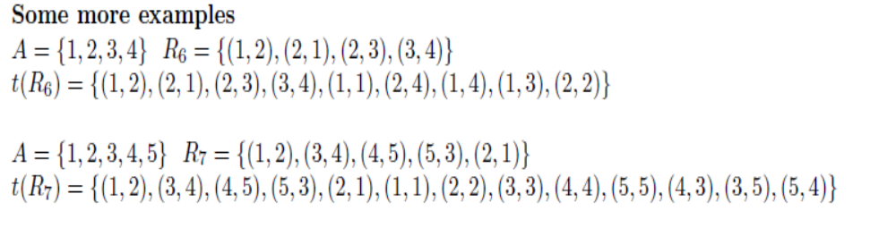
Some More Examples
2CS802 - MFCS

Slide 55
Paths in directed graphs
A path is a sequences of connected edges from vertex a to vertex b
No path exists from
the noted start location
A path that starts and
ends at the same
vertex is called a
circuit or cycle
  Must have length ≥1
Start (a)
End (b)
Start (a)
End (b)
Start (a)
2CS802 - MFCS

Slide 56
More on paths…
The length of a path is the number of edges in the path, not the number of nodes
2CS802 - MFCS

Slide 57

Shortest paths
What is really needed in most applications is finding the shortest path between two vertices
2CS802 - MFCS

Slide 58
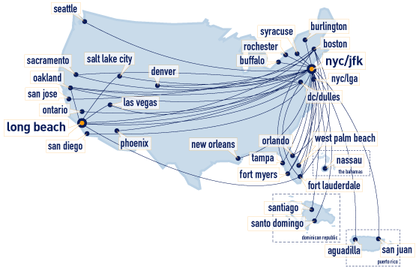
Transitive closure
The transitive closure would contain edges between all nodes reachable by a path of any length
2CS802 - MFCS

Slide 59
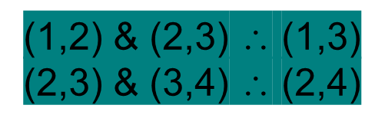

Transitive closure
Informal definition: If there is a path from a to b, then there should be an edge from a to b in the transitive closure
First take of a definition:
  In order to find the transitive closure of a relation R, we add an edge from a to c, when there are edges from a to b and b to c
But there is a path from 1 to 4 with no edge!
4
4
1
1
2
3
2
3
2CS802 - MFCS

Slide 60
Transitive closure
Informal definition: If there is a path from a to b, then there should be an edge from a to b in the transitive closure
Second take of a definition:
  In order to find the transitive closure of a relation R, we add an edge from a to c, when there are edges from a to b and b to c
  Repeat this step until no new edges are added to the relation
red means added on
the first repeat
teal means added on
the second repeat
4
1
2
3
2CS802 - MFCS

Slide 61
THANK YOU
2CS802 - MFCS

